Slide 1
Writing and using procedures
Sub program/procedure
Procedure
- single procedure
- nested procedure
- recursive procedure
CALL and RET instructions

Slide 2
CALL- Call a procedure
Used to transfer execution to a sub program or procedure.
Types
Near call
Far call
Near call
call to a procedure which is in the same code segment as the call instruction
Decrement the sp by 2 and copies the offset of the next instruction after the CALL onto the stack.

Slide 3
FAR call
Call to procedure which is in different segment from the one that contains the CALL instruction
Decrement the sp by 2 and copies the contents of the CS register to the stack

Slide 4
NEAR JUMPS and CALLS
Intrasegment
(CS does not change)
Direct -- IP relative displacement
new IP = old IP + displacement
Allows program relocation with
no change in code.
Indirect -- new IP is in memory or a register.
FAR
Intersegment Direct -- new CS and IP are encoded in
(CS changes) the instruction.
Indirect -- new CS and IP are in memory.

Slide 5
Direct within-segment near call
Syntax: CALL DST
IP← (IP)+16-bit displacement
Example: CALL multo

Slide 6
Indirect within-segment near call
Syntax: CALL DST
IP← (EA)
EXAMPLE: CALL BX
- BX contains the offset of the first instruction’ s procedure
- IP is replaced with a 16-bit value from a specified register or memory location.

Slide 7
Direct inter-segment FAR call
Syntax: CALL DST
IP← 16-bit displacement
CS← segment address
A direct call to another segment
Example: CALL smart-divide

Slide 8
Indirect inter-segment far call
Syntax: CALL DST
IP← (EA)
CS← (EA+2)
Example: CALL dword ptr[bx]
- new values for CS and IP are fetched from 4 memory location in DS.
- the new values for CS is fetched from [bx] and [bx+1] and the new IP is fetched from [bx+2] and [bx+3].

Slide 9
RET-return execution from procedure to calling program
End of the procedure returns execution to the next instruction in the mainline

Slide 10
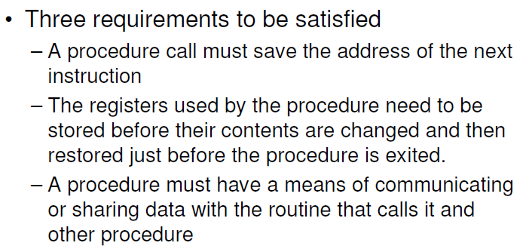

Slide 11
The 8086 stack
Advantages
Section of memory to Store return address
save the contents of registers for the calling program while a procedure executes.
To Hold data or addresses that will be acted upon by a procedure.
Stack segment register:- hold the upper 16-bits of the starting address
Stack pointer:- hold the offset of the last word written on the stack.

Slide 12
Label-directive
Used to give a name to the current value in the location counter
Example:
STACK_SEG SEGMENT STACK
DW 100 DUP(0) ; set aside 100 words for stack
STACK_TOP LABEL WORD ; give name to next ; location after last
STACK_SEG ENDS ; word in stack

Slide 13
Initialization of stack segment register and stack pointer register
STACK_SEG SEGMENT STACK
DW 40 DUP(0) ; set aside 40 words for stack
STACK_TOP LABEL WORD ; give name to next location after last
STACK_SEG ENDS ; word in stack
CODE SEGMENT
ASSUME: CS:CODE, SS: STACK_SEG
MOV AX, STACK_SEG ;initialize ss register
MOV SS, AX
LEA SP, STACK_TOP ;initialize sp continue with program
:
:
CODE ENDS
END

Slide 14
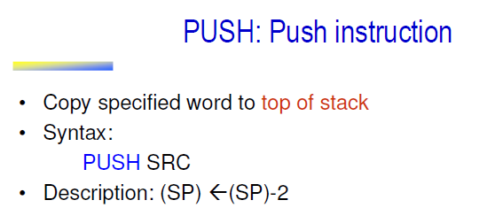
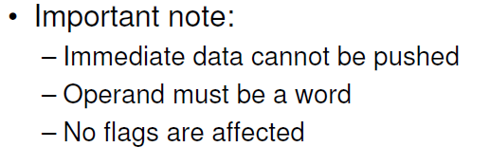
Instruction set

Slide 15
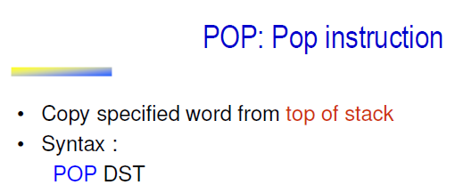



Slide 16
PUSHF: push flags
Push flag register on the stack
Syntax: PUSHF
(Sp)← (sp)-2
No flags are affected

Slide 17
POPF : pop flags
Pop word from top of stack to flag register
Syntax: POPF
(SP)← (SP)+2
Flags are affected

Slide 18
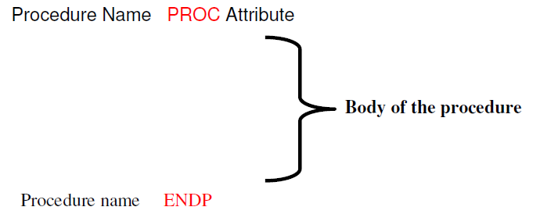
Passing parameters to and from procedure
In registers
In dedicated memory locations accessed by name
With pointers passed in register
With the stack
Syntax for procedure

Slide 19
Consider the example to convert a packed BCD 0100 0101 1001 0110(4596₁₀)to binary. (0001 0001 1111 0100 or 11F4h)

Slide 20
Steps to convert packed BCD number(17) to its binary equivalent
Separate nibbles
Save lower nibble (don’t need to multiply by 1)
Multiply upper nibble by 0Ah
Add lower nibble to result of multiplication

Slide 21
1.Passing parameters in registers
The values we need to pass to procedure are copied from memory to registers and this registers are used inside the procedure.
Here,BCD to binary conversion is written as a procedure and hence the BCD value to be converted is moved to AL reg and AL is used inside the procedure.

Slide 22
data segment
bcd_input db 17h
bin_value db ?
data ends
stack_s segment stack
dw 100 dup(0)
stack_top label word
stack_s ends
code segment
assume cs:code ,ds:data,ss:stack_s
start:mov ax,data
mov ds,ax
mov ax,stack_s
mov ss,ax
mov sp,offset stack_top
mov al,bcd_input
call bcd_bin
mov bin_value,al
bcd_bin proc near
pushf
; push AX
push BX
push CX
; mov al,bcd_input
mov bl,al
and bl,0Fh
and al,0F0h
mov cl,04h
ror al,cl

Slide 23
mov bh,0Ah
mul bh
add al,bl
; mov bin_value,al
pop CX
pop BX
; pop AX
popf
ret
bcd_bin endp
code ends
end start

Slide 24
2.Passing Parameters In General Memory
Instead of moving values to a reg ,the values are directly accessed inside procedure.
Changes to be made are
1.The variable itself is used inside in procedure(mov
al,bcd_input)
2.The result is written to a variable(mov bin_value,al)

Slide 25
3. Passing parameters using pointer
Make use of pointers to pass data values inside procedure.
Offset of data values are moved to SI and DI and these pointers are used inside the procedure.
MOV SI, OFFSET BCD_INPUT
MOV DI, OFFSET BIN_VALUE
CALL BCD_BIN
1.The variable itself is used inside in procedure(mov
al,[SI])
2.The result is written to a variable(mov [DI],al)

Slide 26
4.Passing Parameters Using Stack
push bp
mov bp,sp
mov ax,[bp+10]
………
…….
add al,bl
mov [bp+10],ax
pop bp
pop cx
pop bx
pop ax
ret
mov al,bcd_input
push ax ; moving AL value on ;to the stack.
call bcd_bin
pop ax
mov bin_value,al
bcd_bin proc near
pushf
;
;push ax
push bx
push cx

Slide 27
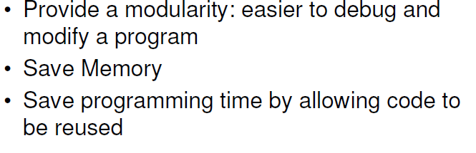
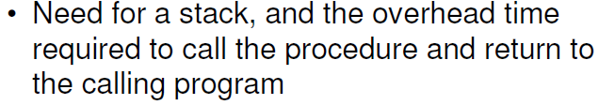
Stack Overflow: stack fills up and overflows the memory space alloted for it. Advantages of procedure
disadvantages of procedure

Slide 28
Writing and debugging programs containing procedures
Module
breakpoints
Re-entrant procedures:
Procedures that can be interrupted, used and re-entered without losing or writing over anything.
To be re-entrant,a procedure must
a)Push the flags and all registers used in the procedure
b)Proc. Pgm should use only reg or stack to pass parameters

Slide 29
Recursive procedure
Process of calling the same function again and again until some condition satisfied.
Example:
- factorial

Slide 30
Writing and Calling Far Procedure
code segment
assume cs:code,ds:data,ss:stack_seg
……
call mul
..
code ends
procedures segment
mul proc far
assume cs:procedures
..
mul endp
procedures end

Slide 31
Factorial of a number using Far procedure
stackseg segment stack
dw 40 dup(0)
tos label word
stackseg ends
dataseg segment public
num db 5
res dw ?
dataseg ends
procedures segment public
extrn fact:far
procedures ends
codeseg segment public
assume cs:codeseg,ds:dataseg,ss:stackseg
start:mov ax,dataseg
mov ds,ax
mov ax,stackseg
mov ss,ax
lea sp,tos
mov al,1
mov ah,00
mov cl,num
call fact
mov res,ax
mov ax,4c00h
int 21h
codeseg ends
end start

Slide 32
; procedure which is called from other program
public fact
procedures segment public
fact proc far
assume cs:procedures
cmp cl,00h
jne l1
mov ah,00
ret
l1:
cmp cl,01h
jne l2
mov ah,00
ret
l2:
mul cl
dec cl
cmp cl,01h
jnz l2
ret
fact endp
procedures ends
end

Slide 33
;eg-2 mainline program
data segment public
dividend dw 000ch, 000ch
divisor dw 002h
quo dw 2 dup(0)
rem dw 0
data ends
stack segment
dw 40 dup(0)
top label word
stack ends
public divisor
code1 segment public
extrn divide : far
code1 ends
code segment
assume cs:code, ds:data, ss:stack
start: mov ax, data
mov ds, ax
mov ax, stack
mov ss, ax
mov sp, offset top
mov ax, dividend
mov dx, dividend+2
mov cx, divisor
call divide
jnc l1
jmp exit
l1:
mov quo, ax
mov quo+2,dx
mov rem, cx
exit: mov ah, 4ch
int 21h
code ends
end start

Slide 34
; procedure which is called from other program
data segment public
extrn divisor: word
data ends
public divide
code1 segment public
assume cs:code1
divide proc far
start:cmp divisor,0
je exit
mov bx, ax
mov ax, dx
mov dx,0000
div cx
mov bp, ax
mov ax, bx
div cx
mov cx, dx
mov dx, bp
clc
jmp exit1
exit: stc
exit1: ret
; mov ah, 4ch
;int 21h
code1 ends
end start

Slide 35
Writing and Using Assembler Macros
Two ways to repeat a set of instructions
a.Procedures b.Macros
a.Procedures
Adv:machine code for a group of instructions in the proc only have to put in memory once.
Disadv.
1.Need of a stack
2.Overhead time required to call the proc. and return to the calling program.

Slide 36
When repeated group of instructions is too short or not appropriate to be written as a proc.,then we use macro.
Macro is a group of instructions we bracket and give a name at the start of the program.
Each time we call macro,the assembler will insert the set of instructions in place of call.(called as expanding macro)
Assembler will generate the machine codes for the set of instructions each time macro is called.

Slide 37
Adv:avoids overhead time in calling and returning from procedure.
Disadv:each time in-line code is generated and hence it use more memory.
Syntax: macroname MACRO
…………..
ENDM
passing parameters to macro
Syntax:
Macroname MACRO parameters
….
ENDM

Slide 38
Example:
Breath_rate proc FAR
Assume cs:procedures, ds:patient_parameters
Push_all ; macro call
Mov ax,patient_parameters ;initialize data
Move DS,AX ;segment register
Push_all MACRO
Pushf
Push ax
Push bx
Push cx
Push bp
Push si
Push di
Push ds
Push es
Push ss
ENDM

